Slide 1
Automation Range Finder Car Project Progress
SEU/IS/19/EG/048 – P. J. Dissanayake

Slide 2
OUTLINE
Review
Hardware used
Progress to date
Limitations and Challengers
Solutions
Programming part
How it Works
Conclusion
End

Slide 3
Review
What is a Automation Range Finder Car?
Why to use this robot car?
In this project, we are designing a robot car that can calculate the altitude of a certain room or building up to some extent.
It can be controlled remotely to reach the places that people cannot reach at once and also in extreme weather situations.

Slide 4
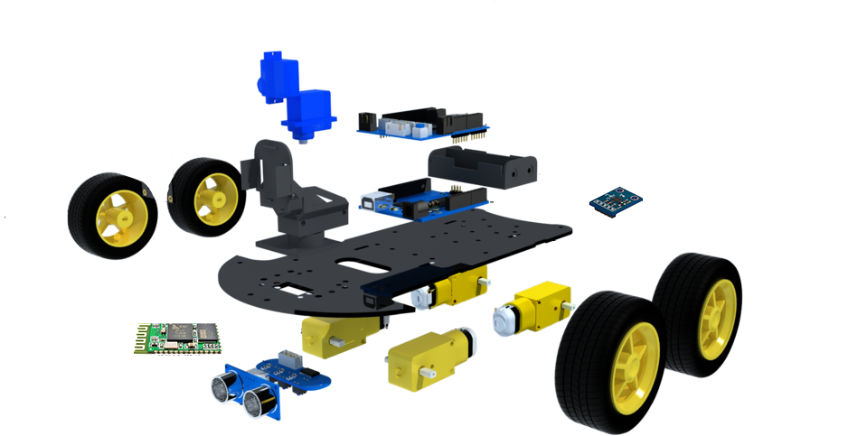
Hardware Used
• Arduino UNO REV3
• Gear motor
• Servo motor
• HC 6 - Bluetooth Module
• Ultrasonic Sensor HC-SR04
• Laser module
• GY-61 DXL335 3-Axis Accelerometer
• L298D motor driver shield

Slide 5
Progress to date
So far our primary focus has been on creating the Arduino code and Android application necessary for the project setup.
Also, the SOLIDWORKS file required for 3D printing of the car chassis was created.
We have found most of the hardware parts, but we need to find the accelerometer sensor.
We have been able to complete the main part of the project.

Slide 6
Limitation and Challenges
One of the main problems in creating the car was finding a Bluetooth app that we needed.
Most of the apps found were unable to do both giving commands and getting readings at the same time.
And it was difficult to find an accelerometer sensor.

Slide 7
Solutions
We decided to create a Bluetooth app to overcome the difficulties.
Finally, we created an Android app using the MIT App Inventor Math Blocks software development platform.

Slide 8
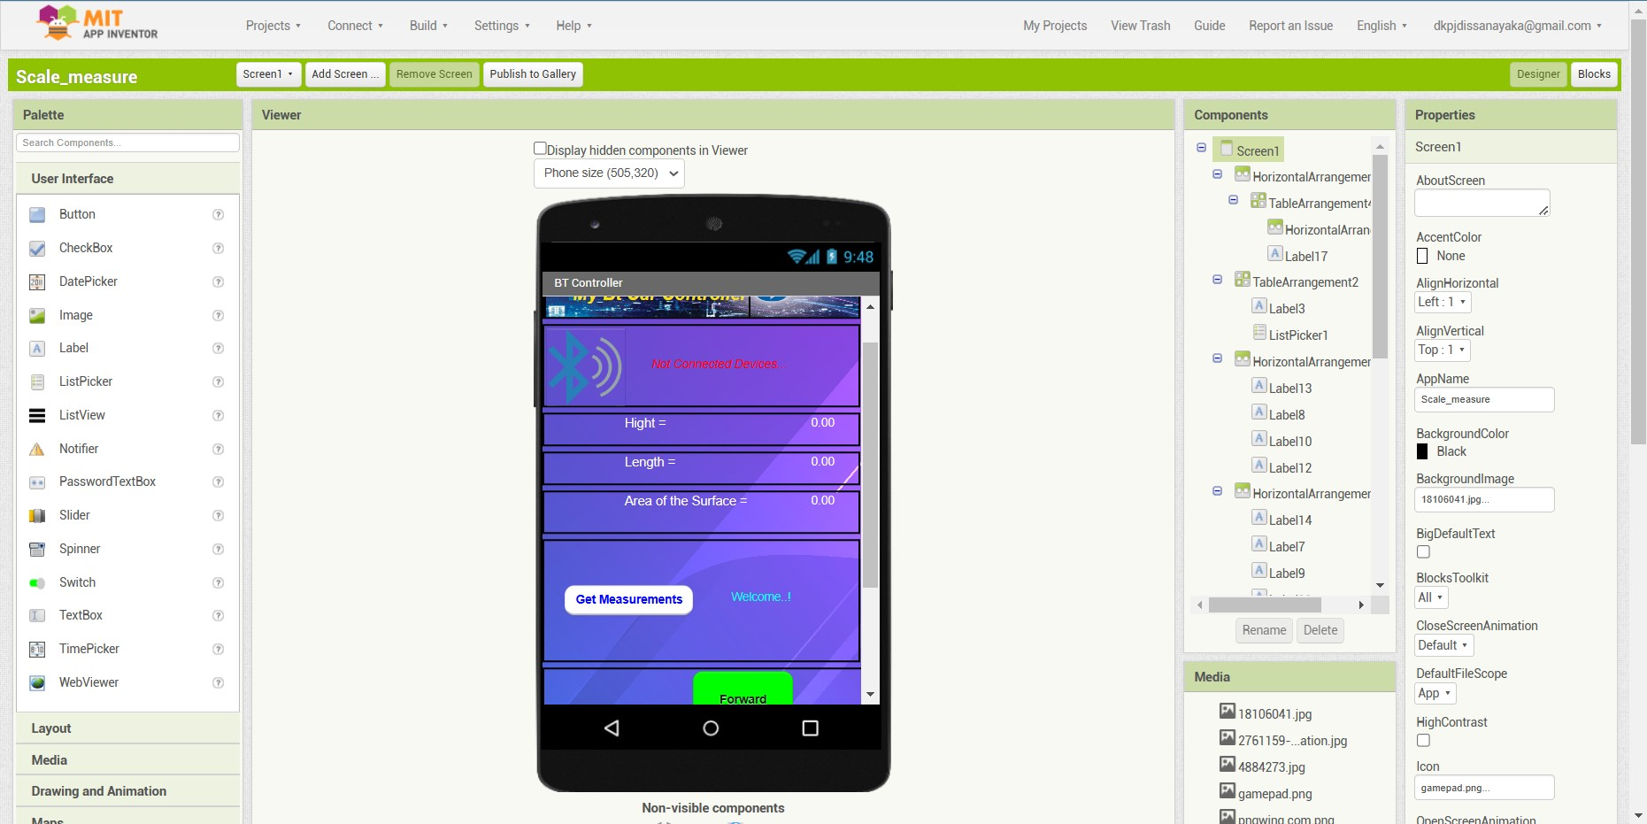
Our Android Application

Slide 9
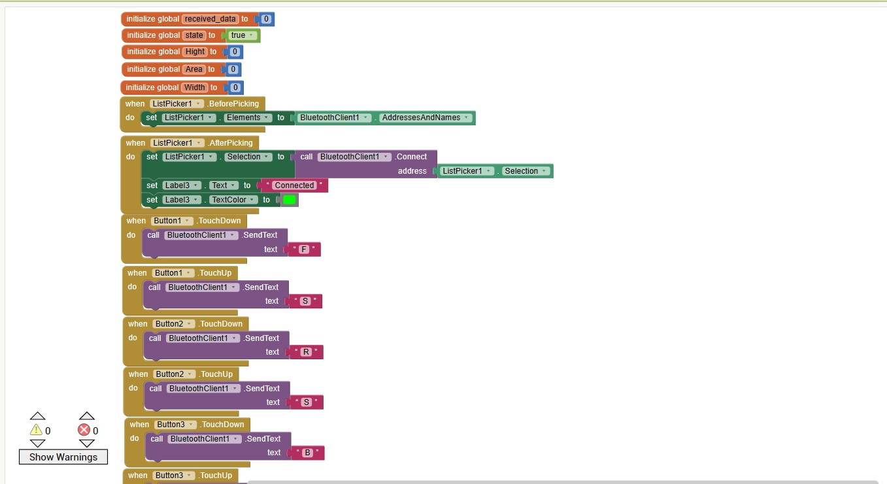
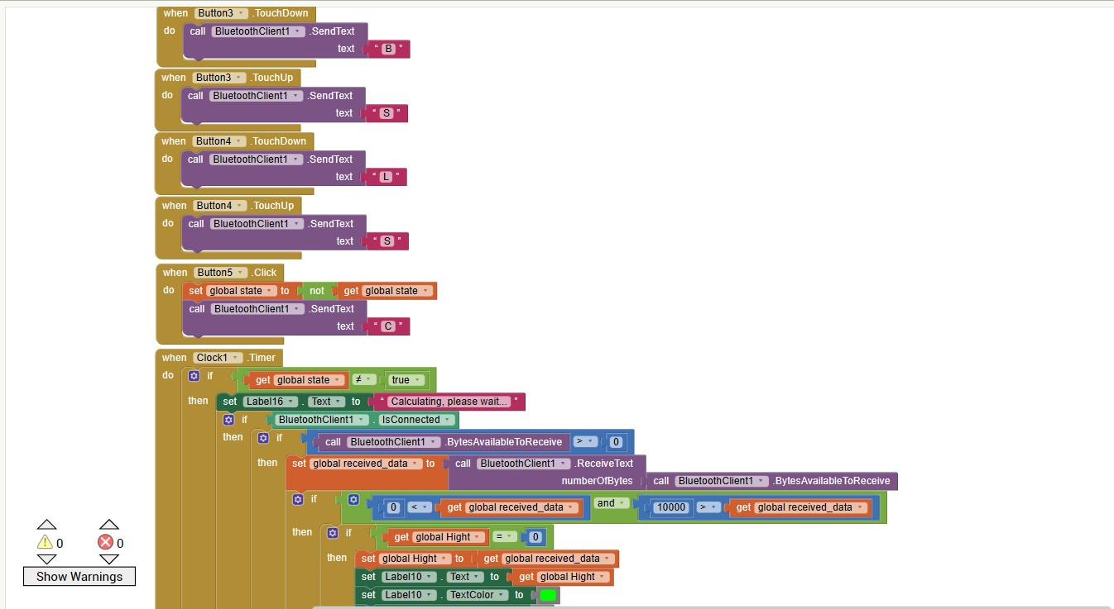

Slide 10
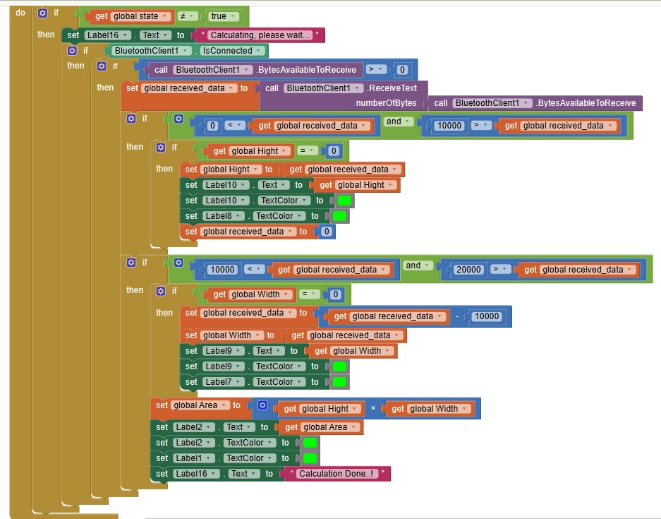

Slide 11
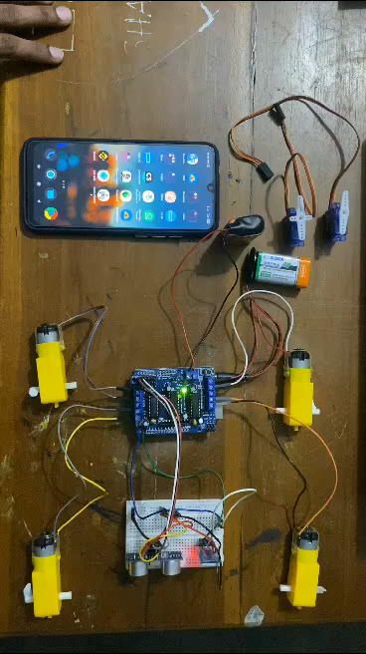
Testing Video

Slide 12
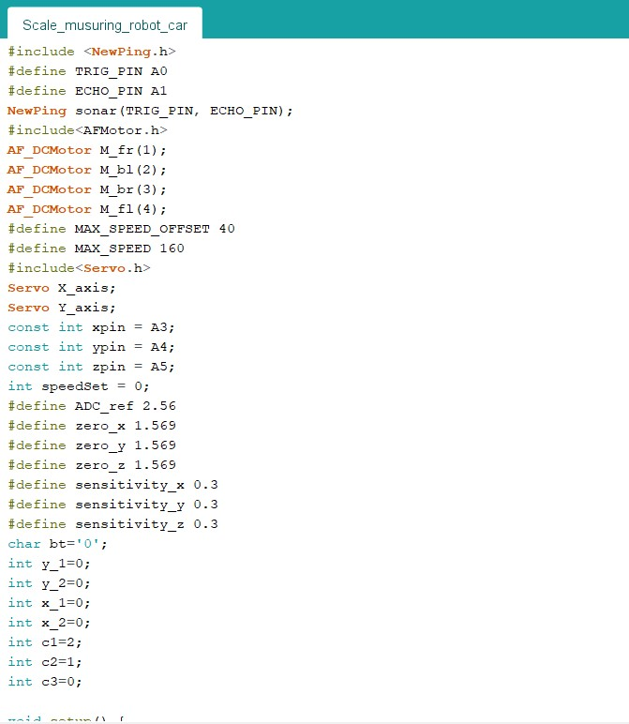
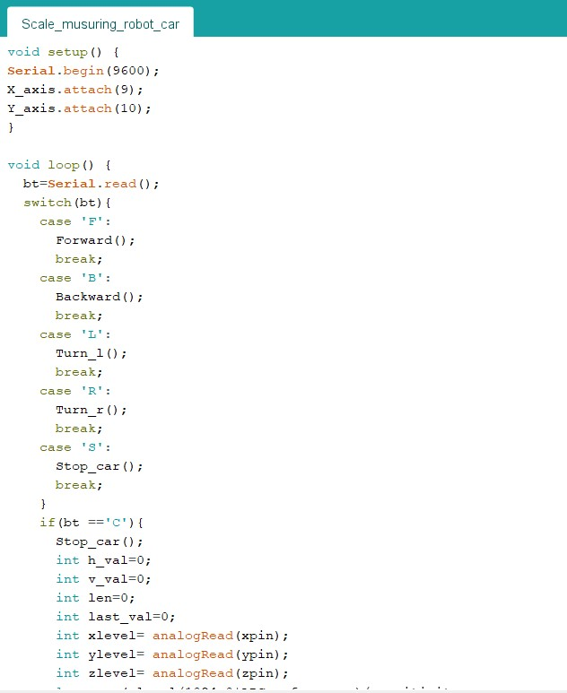
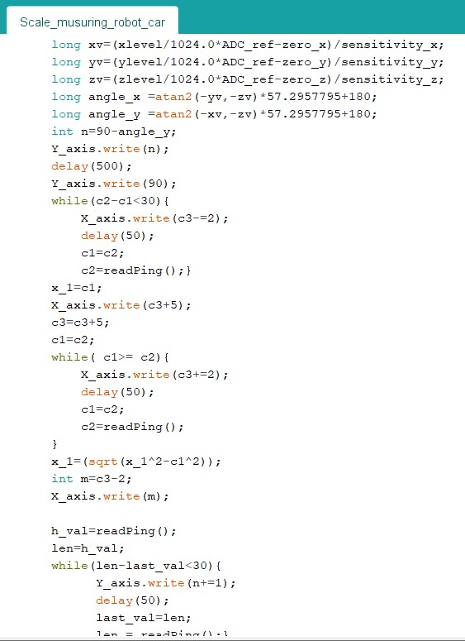
Our Arduino IDE Cord

Slide 13
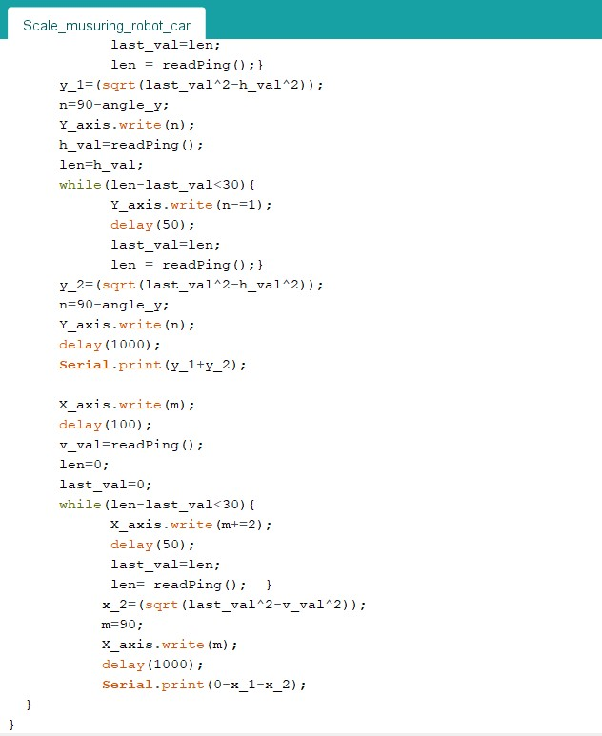
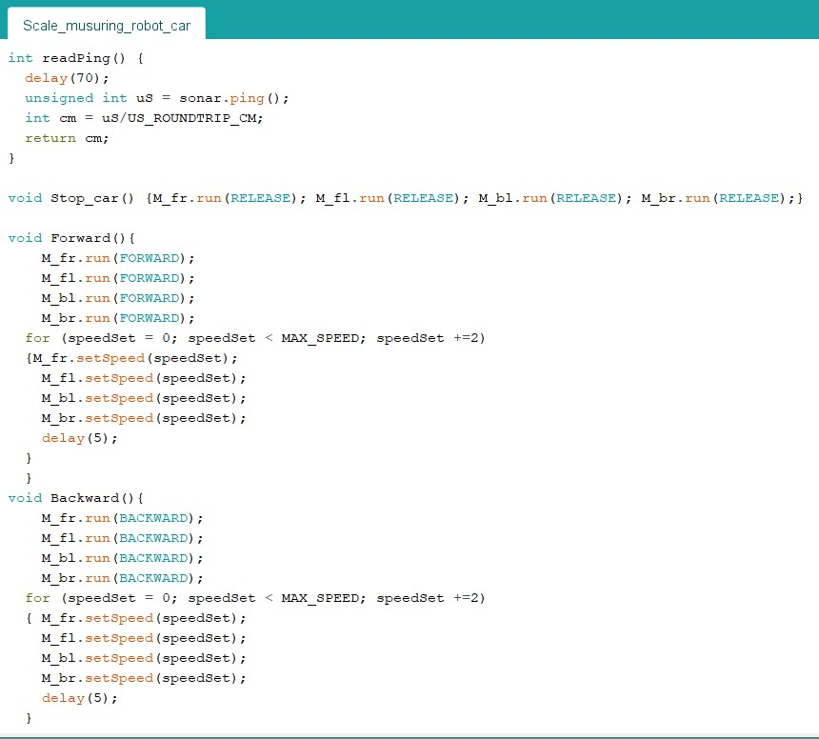
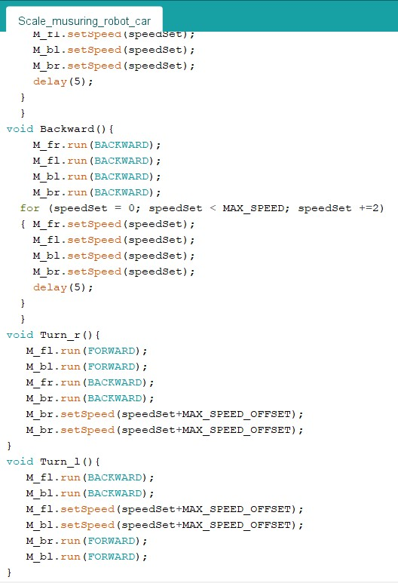

Slide 14

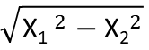
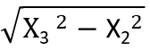
How It Calculates Hight
X₁
Y₁
X₂
Hight = ( + )
$$\sqrt{{\text{X}\text{1} }^{2}−{\text{X}\text{2}}^{2}}$$
$$\sqrt{{\text{X}\text{3} }^{2}−{\text{X}\text{2}}^{2}}$$
Y₂
Width measuring perform the same way
X₃

Slide 15


How It Identify Boundary
X_{1c}
Here the robot calculates the length X₁ from moment to moment. When there is a significant change in position, it is considered a boundary.
X_{1b}
X_{1a}
$$\text{X}\text{1}\text{a}−\text{X}\text{1}\text{b}≅0$$
$$\text{X}\text{1}c−\text{X}\text{1}\text{b}≫0$$
So, X_{1b} is the boundary value.

Slide 16
Budget
 | Equipment | Quantity | Prize (Rs. )
1. | Arduino UNO REV3 | 1 | 2000.00
2. | Gear motor | 4 | 2400.00
3. | Servo motor | 2 | 1200.00
4. | HC 5 - Bluetooth Module | 1 | 1000.00
5. | Ultrasonic Sensor HC-SR04 | 1 | 400.00
6. | Laser module | 1 | 300.00
7. | GY-61 DXL335 3-Axis Accelerometer | 1 | 1200.00
 | Total |  | 8 500.00

Slide 17
Conclusion
Our robot car is capable of accurately measuring on level ground as well as from uneven ground, saving time and reducing errors. The car is easy to use and It can be measure without having to manually transfer scale to a separate. The significance of this project lies in its potential applications in various industries, including construction and Space exploration. We were hoping to apply this technology to drones in near future.

Slide 18
References
[1] Mit.edu, 2023. http://ai2.appinventor.mit.edu/#6079301683118080
(accessed Feb. 03, 2023).
[2] Last Minute Engineers, “How Accelerometer works? Interface ADXL335 with Arduino,” Last Minute Engineers, Nov. 11, 2018. https://lastminuteengineers.com/adxl335-accelerometer-arduino-tutorial/ (accessed Feb. 03, 2023).
‌[3] Darius, “Simple angle meter using ADXL335 accelerometer [Arduino] | electronicsblog.net,” Electronicsblog.net, Jul. 17, 2011. https://www.electronicsblog.net/simple-angle-meter-using-adxl335-accelerometer-arduino/(accessed Feb. 03, 2023).
‌[4] “App inventor 2 : Receive Multiple data from Arduino via Bluetooth,” www.youtube.com. https://www.youtube.com/watch?v=E9EKqMYvLS4 (accessed Feb. 03, 2023).
‌

Slide 19
Thanks!
Any questions?

